Slide 1

Web Technologies(CAP756)
UNIT 1

Slide 2
HTML
HTML stands for Hyper Text Markup Language which is used for creating web pages and web applications. Tim Berners-Lee is known as the father of HTML.
Hyper Text: HyperText simply means "Text within Text." A text has a link within it, is a hypertext. Whenever you click on a link which brings you to a new webpage, you have clicked on a hypertext. HyperText is a way to link two or more web pages (HTML documents) with each other.
Markup language: . A markup language is a set of rules that defines how the layout and presentation of text and images should appear in a digital document. It allows structuring documents, adding formatting, and specifying how different elements should be displayed (or “rendered”) on webpages.

Slide 3
Evolution of Markup Language
GML [Generic Markup Language] at “CERN” Labs 1960
SGML [Standard Generic Markup Language] 1985
Early 1990’s “Tim Berners Lee” introduced “HTML” for “Mosaic” browser.
Published by IETF (Internet Engineering Task Force) 1993
1995 HTML 2.0
1997 HTML 3.2
1999 HTML 4.0
2000 XHTML 1.0 [Required authors to follow the rules of XML, a stricter markup language]
2014 HTML 5.0
2016 HTML 5.1

Slide 4
HTML Editors
HTML text editors are used to create and modify web pages. HTML codes can be written in any text editor including the notepad. One just needs to write HTML in any text editor and save the file with an extension “.html”. Some of the popular HTML text editors are given below:
Notepad
Notepad++
Sublime Text 3
Visual Studio Code

Slide 5
Structure of HTML
<!DOCTYPE>
<html>
<head>
<title>Web page title</title>
</head>
<body>
<h1>Write Your First Heading</h1>
<p>Write Your First Paragraph.</p>
</body>
</html>

Slide 6
<!DOCTYPE>: It defines the document type or it instruct the browser about the version of HTML.
<html > :This tag informs the browser that it is an HTML document. Text between html tag describes the web document. It is a container for all other elements of HTML except <!DOCTYPE>
<head>: It should be the first element inside the <html> element, which contains the metadata(information about the document). It must be closed before the body tag opens.
<title>: It is used to add title of that HTML page which appears at the top of the browser window. It must be placed inside the head tag and should close immediately. (Optional)
<body> : Text between body tag describes the body content of the page that is visible to the end user. This tag contains the main content of the HTML document.
<h1> : Text between <h1> tag describes the first level heading of the webpage.
<p> : Text between <p> tag describes the paragraph of the webpage.

Slide 7
Features of HTML
It is a very easy and simple language. It can be easily understood and modified.
It is very easy to make an effective presentation with HTML because it has a lot of formatting tags.
It is a markup language, so it provides a flexible way to design web pages along with the text.
It facilitates programmers to add a link on the web pages (by html anchor tag), so it enhances the interest of browsing of the user.
It is platform-independent because it can be displayed on any platform like Windows, Linux, and Macintosh, etc.
It facilitates the programmer to add Graphics, Videos, and Sound to the web pages which makes it more attractive and interactive.
HTML is a case-insensitive language, which means we can use tags either in lower-case or upper-case.

Slide 8
HTML Elements
An HTML element is a collection of start and end tags with the content inserted in between them.
The HTML element consists of 3 parts.
Opening tag: It is used to tell the browser where the content material starts.
Closing tag: It is used to tell the browser where the content material ends.
Content: It is the actual content material inside the opening and closing tag.
Syntax:
<tagname > Contents... </tagname>

Slide 9
HTML Attributes
All HTML elements can have attributes
Attributes provide additional information about elements
Attributes are always specified in the start tag
Attributes usually come in name/value pairs like: name="value“
Example:-
<a href="https://abc.com">Hello World</a>
Here, href is the attribute of <a> tag.

Slide 10
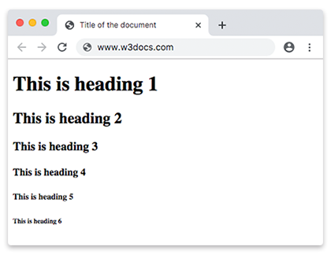
HTML Headings
HTML headings are titles or subtitles that you want to display on a webpage.
HTML headings are defined with the <h1> to <h6> tags.
<h1> defines the most important heading.
<h6> defines the least important heading.
<h1>This is Heading 1</h1>

Slide 11
HTML Paragraphs
The <p> tag defines a paragraph.
Browsers automatically add a single blank line before and after each <p> element.
These have both opening and closing tags. So anything mentioned within <p> and </p> is treated as a paragraph.
Example:-
<p>This is a paragraph 1</p>
<p>This is a paragraph 2</p>

Slide 12
HTML Formatting
HTML Formatting is a process of formatting text for better look and feel. HTML provides us ability to format text without using CSS. There are many formatting tags in HTML. These tags are used to make text bold, italicized, or underlined.
Examples:-
<b>Bold</b>
<i>Italics</i>
<u>Underline</u>

Slide 13
Element name | Description
<b> | This is a physical tag, which is used to bold the text written between it.
<strong> | This is a logical tag, which tells the browser that the text is important.
<i> | This is a physical tag which is used to make text italic.
<em> | This is a logical tag which is used to display content in italic.
<mark> | This tag is used to highlight text.
<u> | This tag is used to underline text written between it.
<sup> | It displays the content slightly above the normal line.
<sub> | It displays the content slightly below the normal line.
<del> | This tag is used to display the deleted content.
<ins> | This tag displays the content which is added
<big> | This tag is used to increase the font size by one conventional unit.
<small> | This tag is used to decrease the font size by one unit from base font size.
https://www.javatpoint.com/html-formatting

Slide 14
HTML Links
A webpage can contain various links that take you directly to other pages and even specific parts of a given page. These links are known as hyperlinks.
Hyperlinks allow visitors to navigate between Web sites by clicking on words, phrases, and images. Thus you can create hyperlinks using text or images available on a webpage.
A link is specified using HTML tag <a>. This tag is called anchor tag and anything between the opening <a> tag and the closing </a> tag becomes part of the link and a user can click that part to reach to the linked document.
<a href = "Document URL" ... attributes-list>Link Text</a>

Slide 15
The Target Attribute
This attribute is used to specify the location where linked document is opened. Various options are as follow:
_blank Opens the linked document in a new window or tab.
_self Opens the linked document in the same frame.
_parent Opens the linked document in the parent frame.
_top Opens the linked document in the full body of the window.
https://www.tutorialspoint.com/html/html_text_links.htm

Slide 16
HTML Head Element
The <head> Element is a container for the following elements:
<title>, <style>,<script>, <link>, etc.
<html> <head> <title>A Meaningful Page Title</title> </head> <body> The content of the document...... </body> </html>

Slide 17
HTML Images
The HTML <img> tag is used to embed an image in a web page.
Images are not technically inserted into a web page; images are linked to web pages. The <img> tag creates a holding space for the referenced image.
The <img> tag is empty, it contains attributes only, and does not have a closing tag.
The <img> tag has two required attributes:
src - Specifies the path to the image
alt - Specifies an alternate text for the image
Syntax:-
<img src="url" alt="alternatetext">

Slide 18
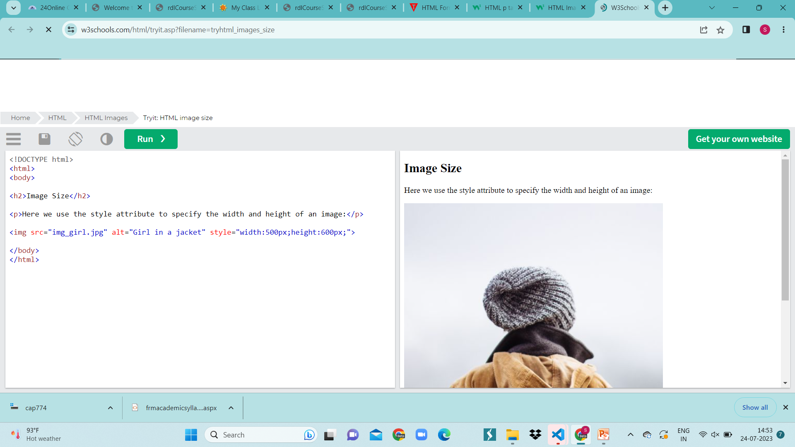

Slide 19
HTML Tables
HTML table tag is used to display data in tabular form (row * column). There can be many columns in a row.
We can create a table to display data in tabular form, using <table> element, with the help of <tr> , <td>, and <th> elements.
In Each table, table row is defined by <tr> tag, table header is defined by <th>, and table data is defined by <td> tags.

Slide 20
Table tags
<table> | It defines a table.
<tr> | It defines a row in a table.
<th> | It defines a header cell in a table.
<td> | It defines a cell in a table.
<caption> | It defines the table caption.
<tbody> | It is used to group the body content in a table.
<thead> | It is used to group the header content in a table.
<tfoot> | It is used to group the footer content in a table.

Slide 21
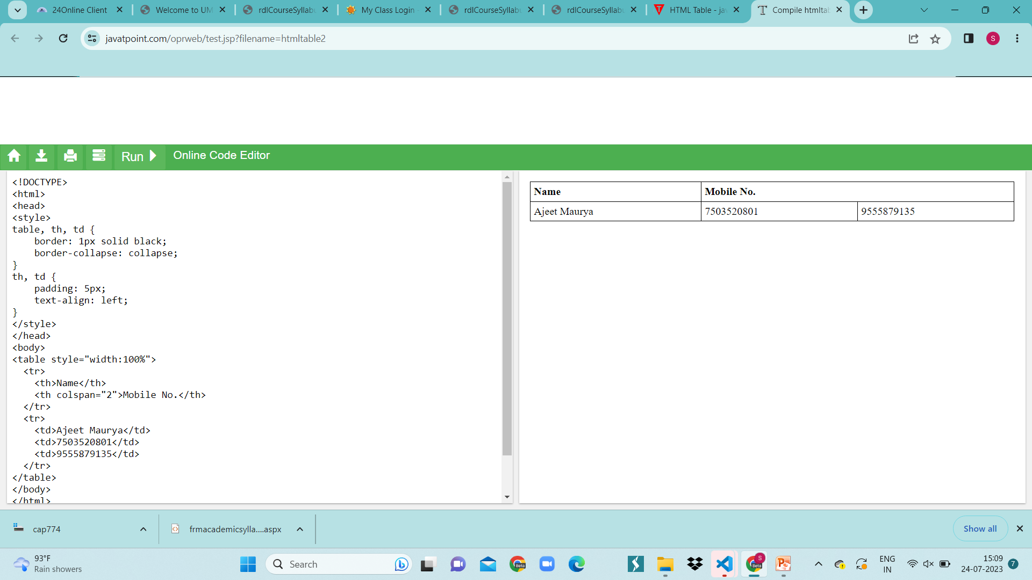
Table colspan
If you want to make a cell span more than one column, you can use the colspan attribute.
It will divide one cell/row into multiple columns, and the number of columns depend on the value of colspan attribute.
<tr>
<th>Name</th>
<th colspan="2">Mobile No.</th>
</tr>
<tr>
<td>Ajeet Maurya</td>
<td>7503520801</td>
<td>9555879135</td>
</tr>

Slide 22
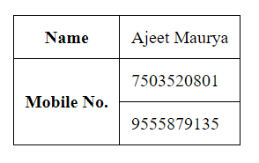
Table rowspan
If you want to make a cell span more than one row, you can use the rowspan attribute.
It will divide a cell into multiple rows. The number of divided rows will depend on rowspan values.
<table>
<tr><th>Name</th><td>Ajeet Maurya</td></tr>
<tr><th rowspan="2">Mobile No.</th><td>7503520801</td></tr>
<tr><td>9555879135</td></tr>
</table>

Slide 23
Cellpadding | Cellspacing
It specifies the space between the border of a table cell and its contents. | It specifies the space between adjacent cells.
It is created by using HTML <table> tag but type attribute is set to cellpadding. | It is also created by using HTML <table> tag but type attribute is set to cellspacing.
It is mainly meant for a single cell. | Cellspacing can get subjected to more than one cell.
The default cellpadding value is 1 | Whereas, the default cellspacing value is 2
Cellpadding is widely used and considered to be an effective mean | Cellspacing is less effective than Cellpadding.

Slide 24
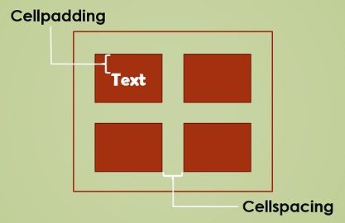
<table style="width:70%;" cellspacing="20px” cellpadding=“10px”>

Slide 25
HTML Lists
HTML Lists are used to specify lists of information. All lists may contain one or more list elements. There are three different types of HTML lists:
Ordered List or Numbered List (ol)
Unordered List or Bulleted List (ul)
Description List or Definition List (dl)

Slide 26
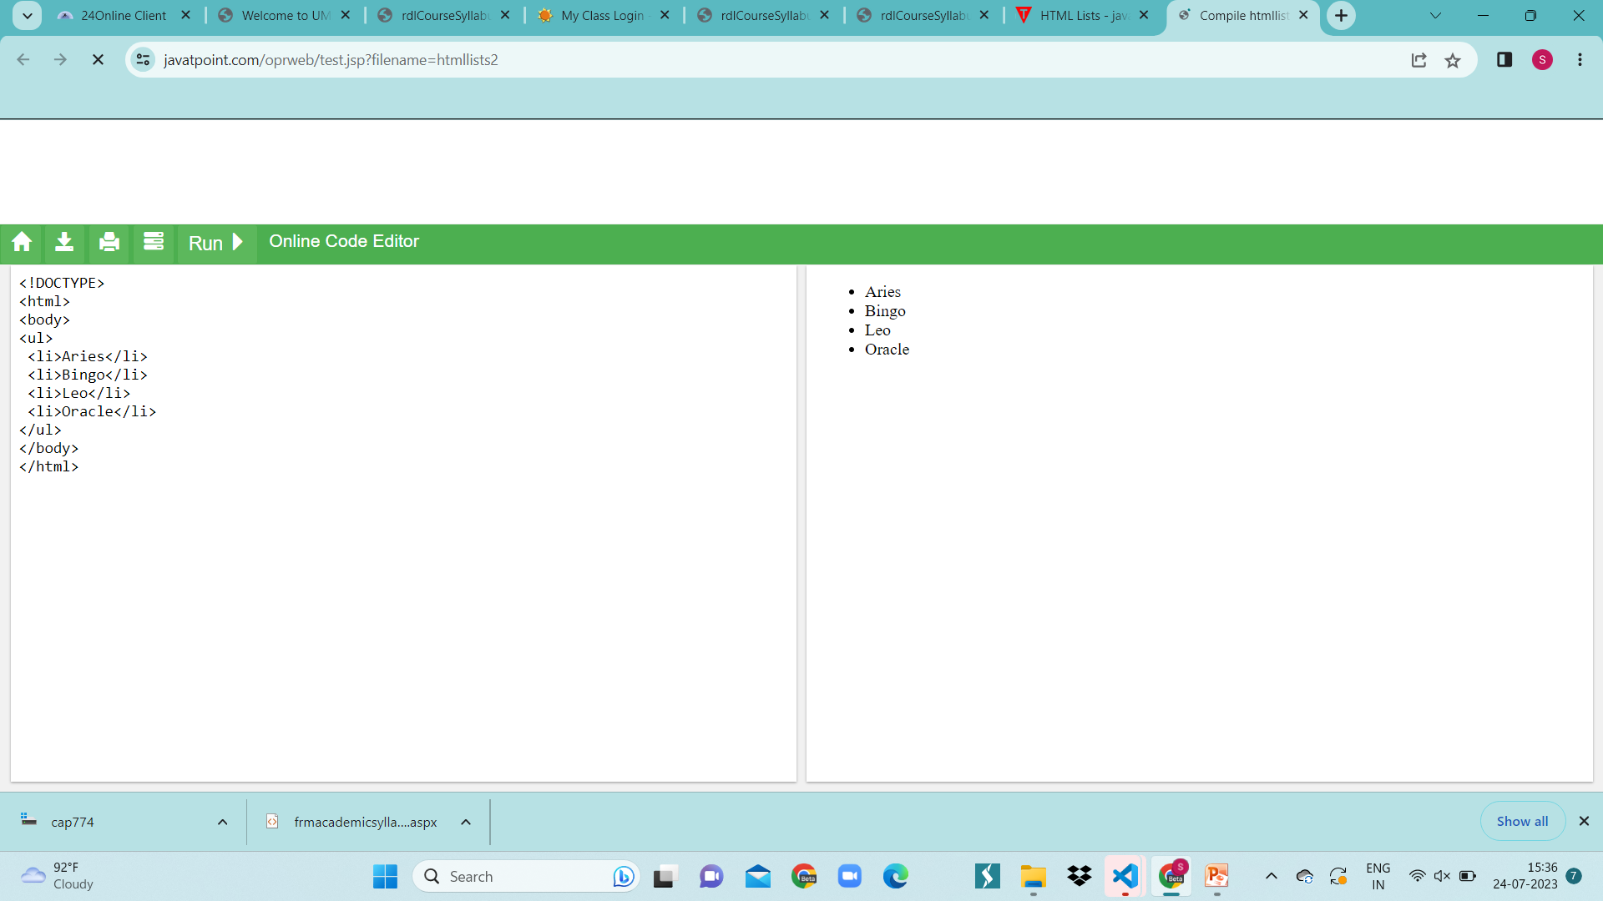
Unordered Lists or Bulleted Lists
In HTML Unordered list, all the list items are marked with bullets. It is also known as bulleted list also. The Unordered list starts with <ul> tag and list items start with the <li> tag.
<ul>
<li>Aries</li>
<li>Bingo</li>
<li>Leo</li>
<li>Oracle</li>
</ul>

Slide 27

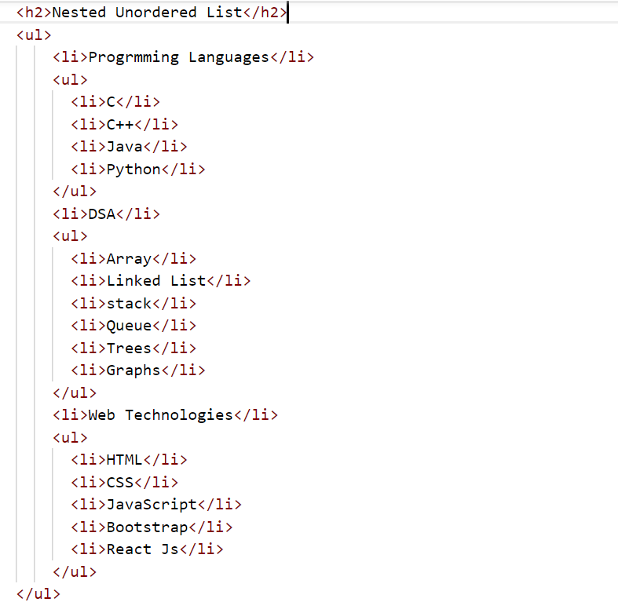
Nested Unordered List

Slide 28
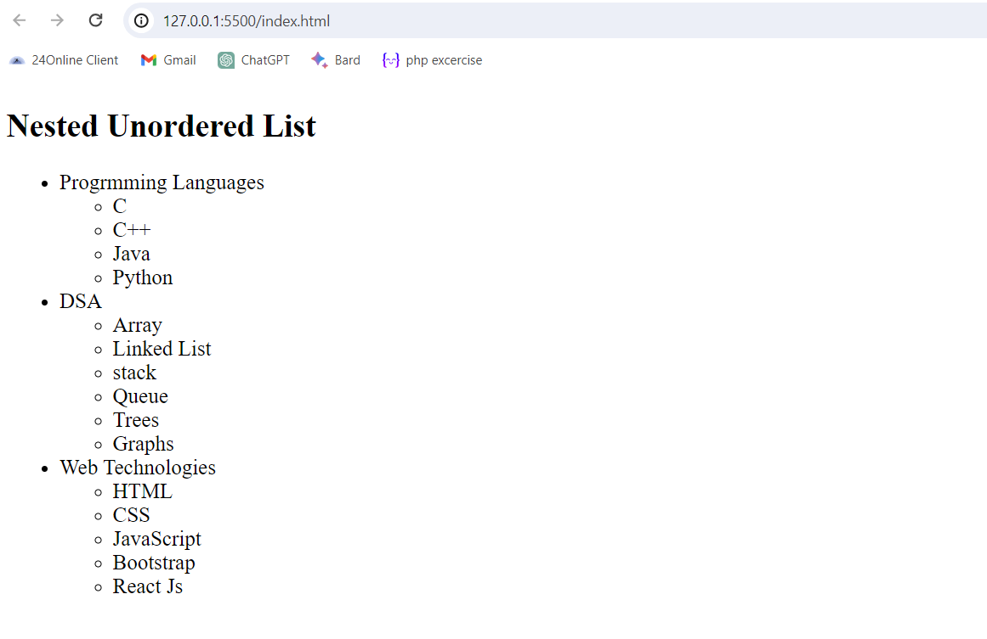

Slide 29

Ordered Lists or Numbered Lists
In the ordered HTML lists, all the list items are marked with numbers by default. It is known as numbered list also. The ordered list starts with <ol> tag and the list items start with <li> tag.
<ol>
<li>Aries</li>
<li>Bingo</li>
<li>Leo</li>
<li>Oracle</li>
</ol>

Slide 30
Attribute of Ordered List
Reversed
This Boolean attribute specifies that the list's items are in reverse order. Items will be numbered from high to low.
Start
An integer to start counting from for the list items. Always an Arabic numeral (1, 2, 3, etc.), even when the numbering type is letters or Roman numerals.

Slide 31
Type
Sets the numbering type:
a for lowercase letters
A for uppercase letters
i for lowercase Roman numerals
I for uppercase Roman numerals
1 for numbers (default)

Slide 32
Description List or Definition List
HTML Description list is also a list style which is supported by HTML and XHTML. It is also known as definition list where entries are listed like a dictionary or encyclopedia.
The HTML definition list contains following three tags:
<dl> tag defines the start of the list.
<dt> tag defines a term.
<dd> tag defines the term definition (description).

Slide 33
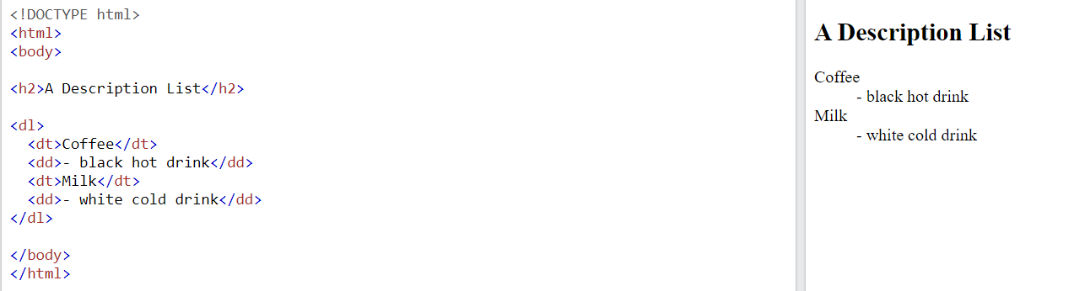
HTML Lists

Slide 34
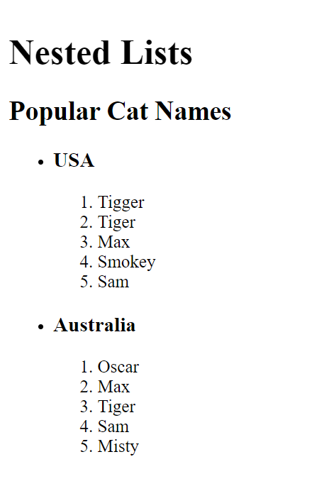
Try This……!

Slide 35
Block Elements
A block-level element always starts on a new line, and the browsers automatically add some space (a margin) before and after the element.
A block-level element always takes up the full width available (stretches out to the left and right as far as it can).
Two commonly used block elements are: <p> and <div>.
The <p> element defines a paragraph in an HTML document.
The <div> element defines a division or a section in an HTML document.

Slide 36
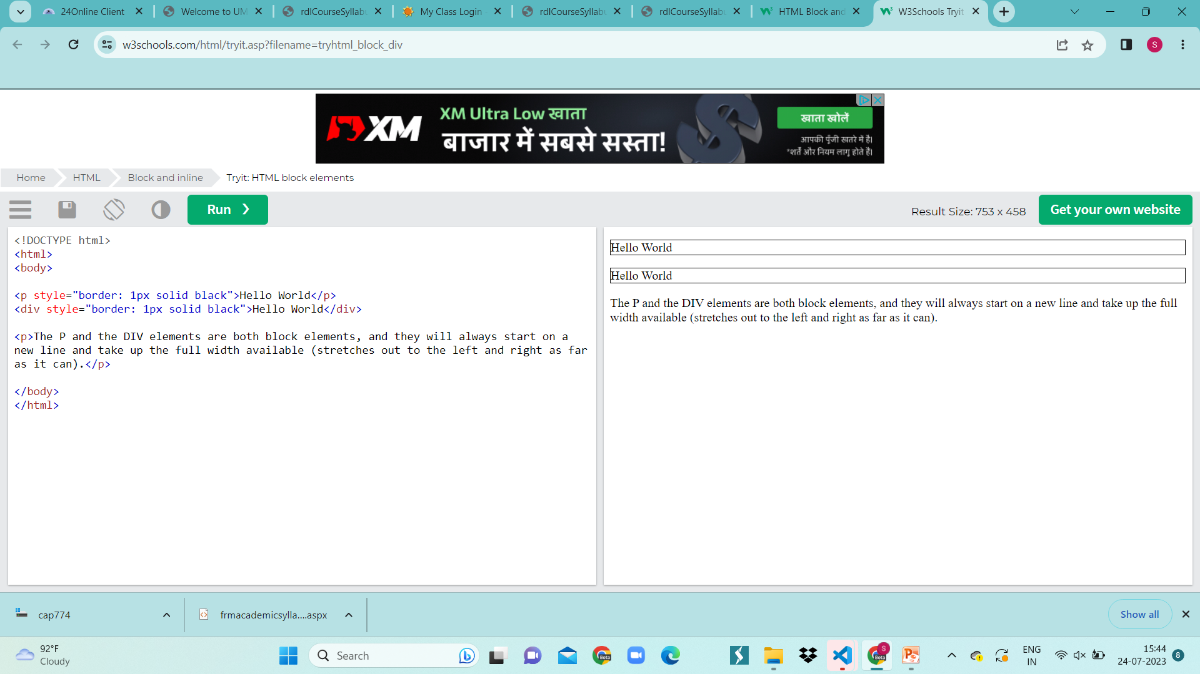
Example of Block Element

Slide 37
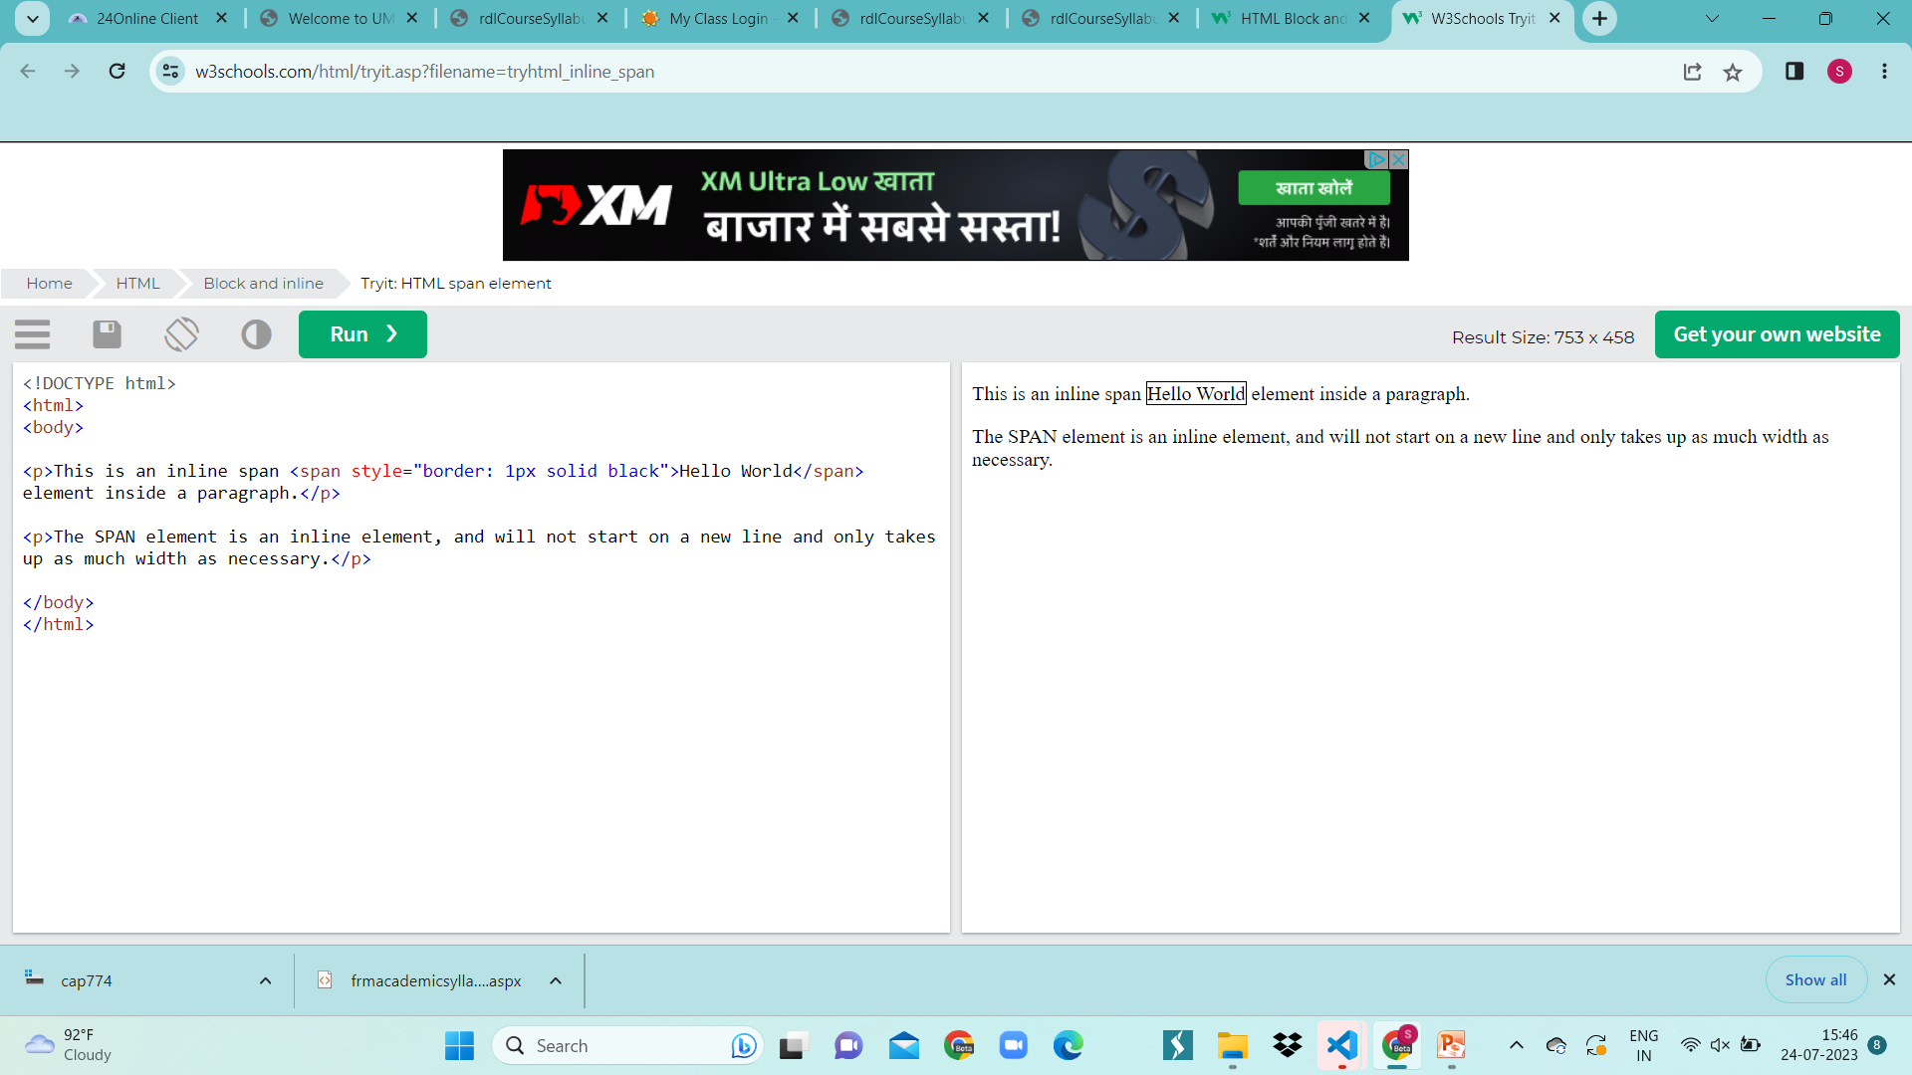
Inline Elements
An inline element does not start on a new line.
An inline element only takes up as much width as necessary.
This is a <span> element inside a paragraph.

Slide 38
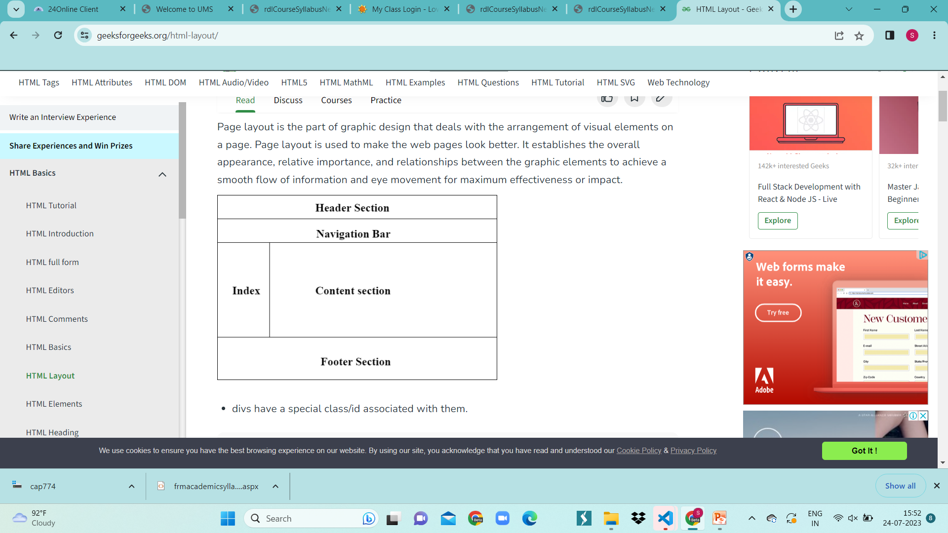
HTML Layout
HTML layouts provide a way to arrange web pages in well-mannered, well-structured, and in responsive form or we can say that HTML layout specifies a way in which the web pages can be arranged. Web-page layout works with arrangement of visual elements of an HTML document.

Slide 39
<header>: It is used to define a header for a document or a section.
<nav>: It is used to define a container for navigation links
<section>: It is used to define a section in a document
<aside>: It is used to define content aside from the content (like a sidebar)
<footer>: It is used to define a footer for a document or a section
<details>: It is used to define additional details
<summary>: It is used to define a heading for the <details> element
https://www.javatpoint.com/html-layout

Slide 40
HTML Forms
An HTML form is a section of a document which contains controls such as text fields, password fields, checkboxes, radio buttons, submit button, menus etc.
An HTML form facilitates the user to enter data that is to be sent to the server for processing such as name, email address, password, phone number, etc. .
Why we need HTML Forms?
HTML forms are required if you want to collect some data from of the site visitor.
For example: If a user want to purchase some items on internet, he/she must fill the form such as shipping address and credit/debit card details so that item can be sent to the given address.
<form action="server url" method="get|post">
//input controls e.g. textfield, textarea, radiobutton, button
</form>

Slide 41
Tag | Description
<form> | It defines an HTML form to enter inputs by the used side.
<input> | It defines an input control.
<textarea> | It defines a multi-line input control.
<label> | It defines a label for an input element.
<fieldset> | It groups the related element in a form.
<legend> | It defines a caption for a <fieldset> element.
<select> | It defines a drop-down list.
<option> | It defines an option in a drop-down list.
<button> | It defines a clickable button.

Slide 42
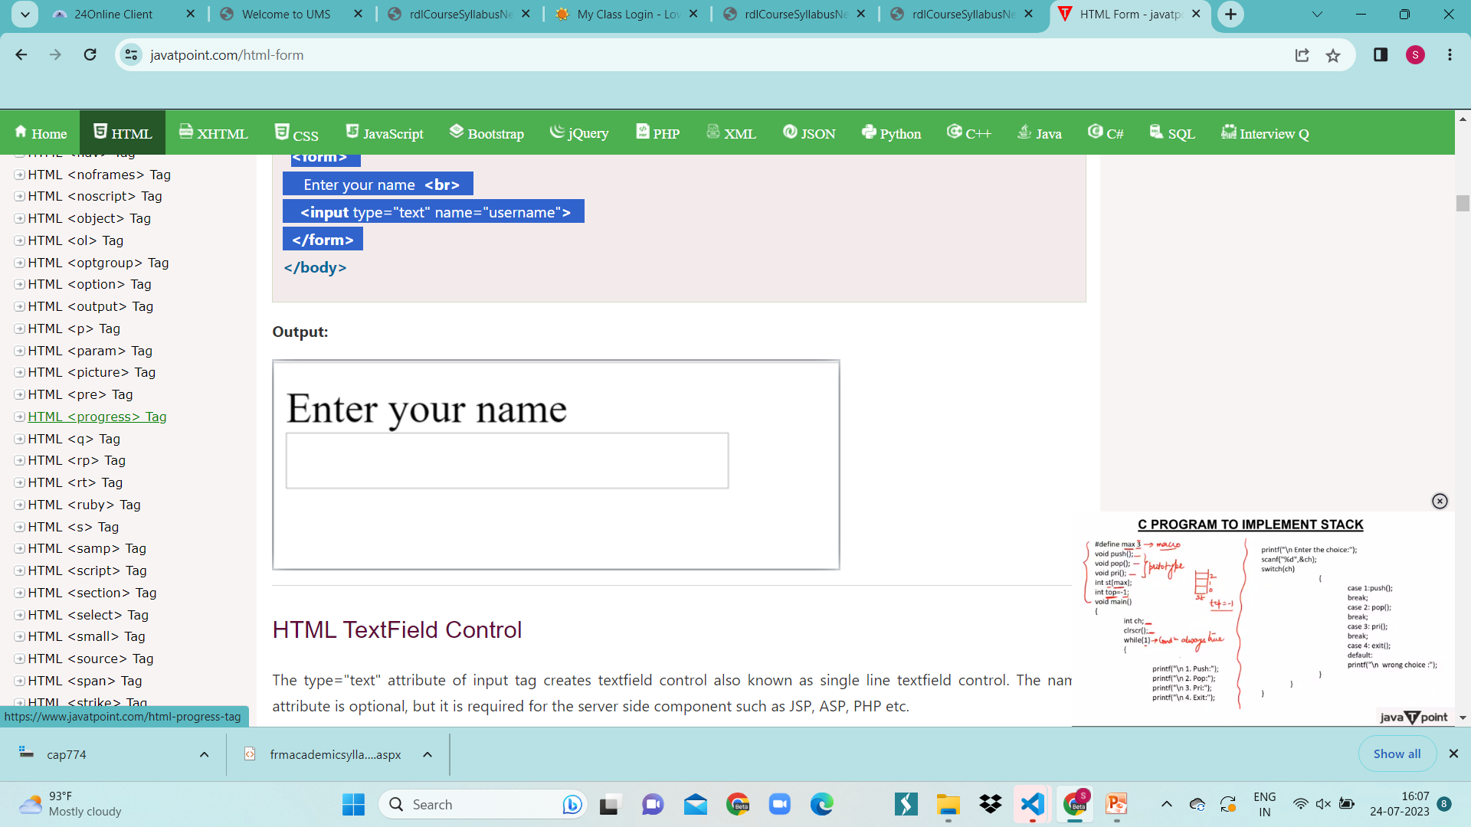
Input Element
The HTML <input> element is fundamental form element. It is used to create form fields, to take input from user. We can apply different input filed to gather different information form user.
<form>
Enter your name <br>
<input type="text" name="username">
</form>

Slide 43
Textarea
The <textarea> tag in HTML is used to insert multiple-line text in a form. The size of <textarea> can be specify either using "rows" or "cols" attribute.
<form>
Enter your address:<br>
<textarea rows="2" cols="20"></textarea>
</form>

Slide 44
Password Field
Email Field
The password is not visible to the user in password field control.
<form>
<label for="password">Password: </label>
<input type="password" id="password" name="password"/> <br/>
</form>
It validates the text for correct email address. You must use @ and . in this field.
<form>
<label for="email">Email: </label>
<input type="email" id="email" name="email"/> <br/>
</form>

Slide 45
Radio Button
Checkbox
The radio button is used to select one option from multiple options. It is used for selection of gender, quiz questions etc.
If you use one name for all the radio buttons, only one radio button can be selected at a time.
Using radio buttons for multiple options, you can only choose a single option at a time.
The checkbox control is used to check multiple options from given checkboxes.
Submit Button
HTML <input type="submit"> are used to add a submit button on web page. When user clicks on submit button, then form get submit to the server.
Syntax:
<input type="submit" value="submit">

Slide 46
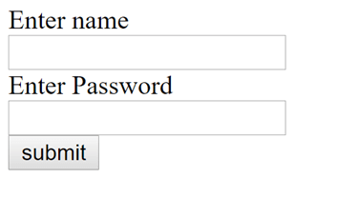
Example of HTML Form
<form>
<label for="name">Enter name</label><br>
<input type="text" id="name" name="name"><br>
<label for="pass">Enter Password</label><br>
<input type="Password" id="pass" name="pass"><br>
<input type="submit" value="submit">
</form>

Slide 47
HTML Iframes
HTML Iframe is used to display a nested webpage (a webpage within a webpage). The HTML <iframe> tag defines an inline frame, hence it is also called as an Inline frame.
An HTML iframe embeds another document within the current HTML document in the rectangular region.
Syntax
<iframe src="URL"></iframe>

Slide 48
Iframe - Target for a Link
<html>
<body>
<h2>Iframe - Target for a Link</h2>
<iframe height="300px" width="100%" src="new.html" name="iframe_a"></iframe>
<p><a href="https://www.javatpoint.com" target="iframe_a">JavaTpoint.com</a></p>
<p>The name of iframe and link target must have same value else link will not open as frame. </p>
</body>
</html>

Slide 49
Colors
HTML colors are specified with predefined color names, or with RGB, HEX values.
HTML supports 140 standard color names.
Background Color
You can set the background color for HTML elements.
<h1 style="background-color:DodgerBlue;">Hello World</h1> <p style="background-color:Tomato;">Hello World</p>

Slide 50
Text Color
You can set the color of text
<h1 style="color:red;">Hello World</h1>
Color Values
In HTML, colors can also be specified using RGB values, HEX values, HSL values, RGBA values, and HSLA values.
The following three <div> elements have their background color set with RGB, HEX values
<h1 style="background-color:rgb(255, 99, 71);">...</h1> <h1 style="background-color:rgba(255, 99, 71, 0.5);">...</h1>

Slide 51
HTML Entities
Some characters are reserved in HTML.
If you use the less than (<) or greater than (>) signs in your text, the browser might mix them with tags.
Character entities are used to display reserved characters in HTML.
A character entity looks like this:
&entity_name;OR
&#entity_number;
To display a less than sign (<) we must write &lt or &#60
Advantage of using an entity name: An entity name is easy to remember. Disadvantage of using an entity name: Browsers may not support all entity names, but the support for entity numbers is good.

Slide 52
&nbsp;
&nbsp; is a commonly used entity in HTML is the non-breaking space.
A non-breaking space is a space that will not break into a new line.
Two words separated by a non-breaking space will stick together (not break into a new line).
Example: 10 am
Here, we need space between 10 and am if we simply write it without using &nbsp; it will appear as 10am.
If you write 10 spaces in your text, the browser will remove 9 of them. To add real spaces to your text, you can use the &nbsp; character entity.

Slide 53
URL Encode
A URL is another word for a web address.
A URL can be composed of words (e.g. w3schools.com), or an Internet Protocol (IP) address (e.g. 192.68.20.50).
Most people enter the name when surfing, because names are easier to remember than numbers.
URLs can only be sent over the Internet using the ASCII character-set. If a URL contains characters outside the ASCII set, the URL has to be converted.
URL encoding converts non-ASCII characters into a format that can be transmitted over the Internet.
URL encoding replaces non-ASCII characters with a "%" followed by hexadecimal digits.
URLs cannot contain spaces. URL encoding normally replaces a space with a plus (+) sign, or %20.

Slide 54
Quick List
The following is an HTML Quick List:
Heading Element <h1></h1> <h2></h2> <h3></h3> <h4></h5> <h6></h6>
Text Element : <p></p> paragraph <br> line break <hr> horizontal rule
Physical Style <b></b> bold <i></i> italic

Slide 55
Unordered (bullet) List <ul> <li>First Item</li> <li>Second Item</li> </ul>
Ordered (Number) List <ol> <li>First Item</li> <li>Second Item</li> </ol>
Tables <table border ="1"> <tr> <th>some heading</th> <th>some heading</th> </tr> <tr> <td>sometext</td> <td>sometext</td> </tr> </table>

Slide 56
Forms
<form action="" method="post">
<p>Name:</p> <p><input type="text" name="name" value="Your name"></p>
<p>Comments: </p> <p><textarea name="comments" rows="5" cols="20">Your comments</textarea></p>
<p>Gender:</p> <p><input type="radio" name="gender" value="male"> Male</p> <p><input type="radio" name="gender" value="female"> Female</p>
<p><input type="submit"></p>
</form>
Image Element
<img src ="" />
Links
<a href ="http://www.examples.com /"> This is a link </a>

Slide 57
XHTML
XHTML stands for Extensible HyperText Markup Language. It is the next step to evolution of internet. The XHTML was developed by World Wide Web Consortium (W3C). It helps web developers to make the transition from HTML to XML.
XHTML stands for EXtensible HyperText Markup Language
XHTML is almost identical to HTML
XHTML is stricter than HTML
XHTML is supported by all major browsers

Slide 58
Why XHTML??
Many pages on the internet contain "bad" HTML.
This HTML code works fine in most browsers (even if it does not follow the HTML rules):
XHTML is used to define the quality standard of web pages.
<html> <head> <title>This is bad HTML</title> <body> <h1>Bad HTML <p>This is a paragraph </body>

Slide 59
Today's market consists of different browser technologies.
Some browsers run on computers, and some browsers run on mobile phones or other small devices.
XML is a markup language where documents must be marked up correctly (be "well-formed").
By combining the strengths of HTML and XML, XHTML was developed.
XHTML is HTML redesigned as XML.

Slide 60
The most Important difference from HTML
Document Structure
XHTML Elements
XHTML Attributes

Slide 61
Document Structure
XHTML DOCTYPE is mandatory
The xmlns attribute in <html> is mandatory
<html>, <head>, <title>, and <body> are mandatory
XHTML ELEMENTS
XHTML elements must be properly nested
XHTML elements must always be closed
XHTML elements must be in lowercase

Slide 62
XHTML ATTRIBUTES
Attribute names must be in lower case
Attribute values must be quoted

